Slide 1


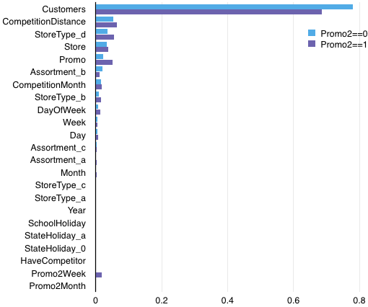





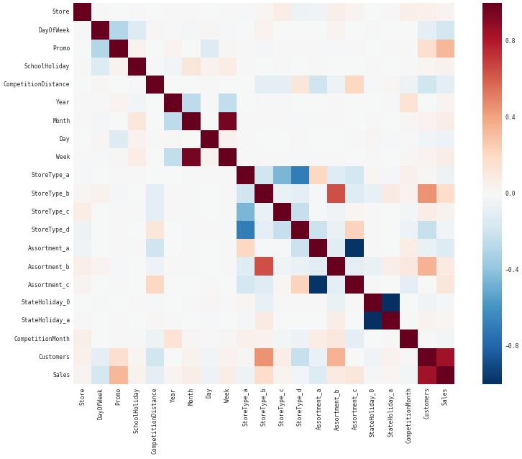
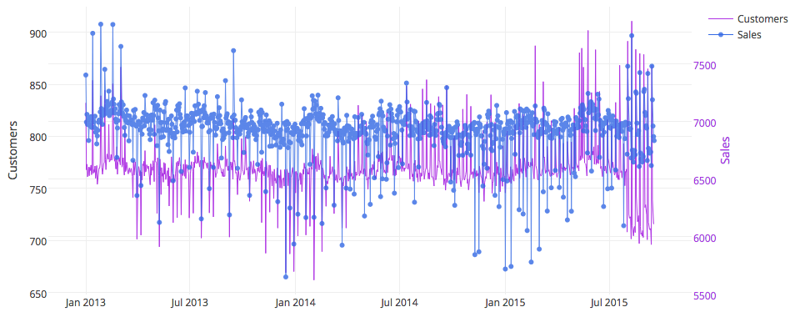
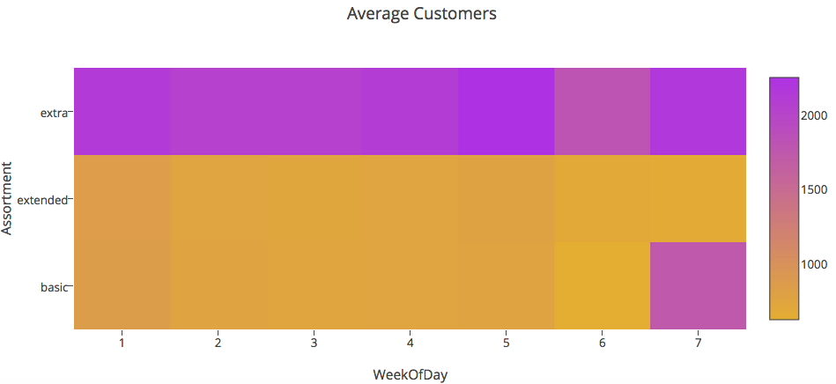
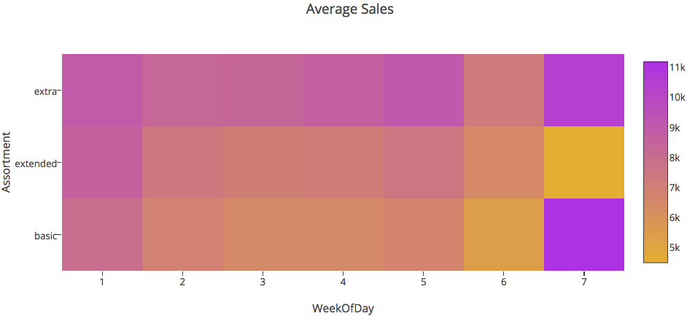
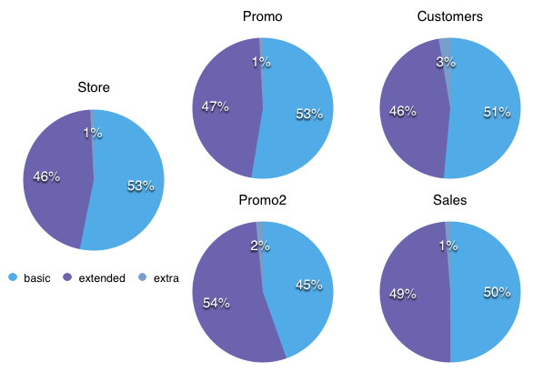
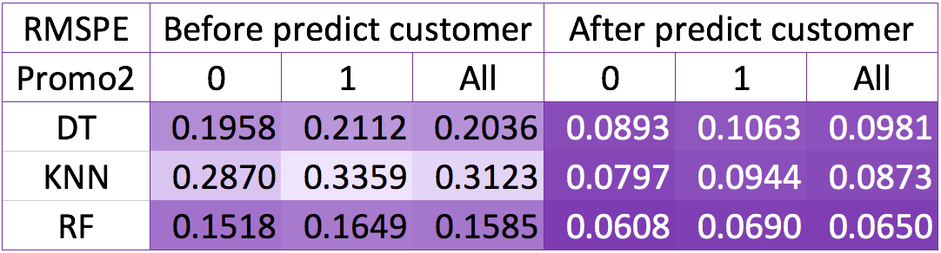
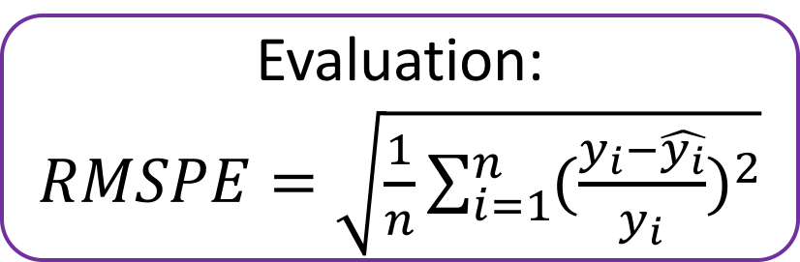
Prediction of Rossmann Store Sales Yilin Wei, Tingting Gao, Jialu Yan Instructor: Dr. German Creamer
Business Intelligence & Analytics
Briefing
Methodology
The goal of this project is to predict Rossmann store Sales with different periods data and different algorithms. This help us to learn the effects of promotion and arrange supply chain management, investment and workforce.
Feature Importance
Customers, CompetitionDistance and StoreType_b are important features for both train datasets
3,000 drug stores in 7 European countries
Methodology
Exploration
Customers, Promo and StoreType_b positively relate to Sales
DayofWeek and Assortment_a highly negately relate to Sales
Modeling Process
Separately split train and test into two based on Promo2(0 or 1)
Because Customer highly relate to Sales, predict Customer for test
Compared with decision tree and KNN, random forest performs the best
Correlation Matirx for Train (Promo2==0)
Analysis
Predictions are effective at first and then fluctuate more than the real data. We should use time series analysis to improve accuracy
Sunday and Monday have more customers and sales
Extra assortment stores have more customers and sales
Store table: information of 1115 stores
Merge into one table
Sales table: sales during 2013-1-1 2015-7-31
Features
Store | SchoolHoliday
Day of week | HaveCompetitor
Promo | CompetitionDistance
Year | CompetitionMonth
Month | Dummies of StoreType
Day | Dummies of Assortment
Week | StateHoliday
Train: Promo2==0
…
Algorithm 1
Basic stores conduct more short-term promotion than email marketing
Extended stores conduct more email marketing than short-term promotion
The customers of extended stores are more profitable than that of basic store
Test:Promo2==0
Predict Customers for test data
Test:Promo2==1
Train: Promo2==1
…
Promo2Month
Promo2Week
Algorithm2
Prediction
Evaluation:
$RMSPE=\sqrt{\frac{1}{n}\sum_{i=1}^{n}{{(\frac{y_{i}−\hat{y_{i}}}{y_{i}})}^{2}}}$
http://www.stevens.edu/howe/academics/graduate/business-intelligence-analytics

